Slide 1

Investment Analytics System
Using Machine Learning
2nd Progress Report (6.14)
Group members:
Du Jianzhang, Wu Zhouyin, Yang Anjinyu, Xie Tianyou
Notes:
(DOSB) acceptance of chess
(a) a sport has to
include some form of physical activity; (b) it should convey ethical values, such as fair play, equal opportunities, as well as a
person’s inviolability; and (c) clear organisational structures need to be existent

Slide 2
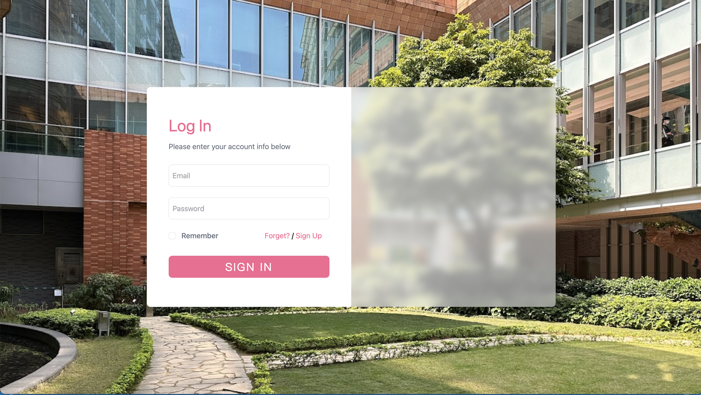
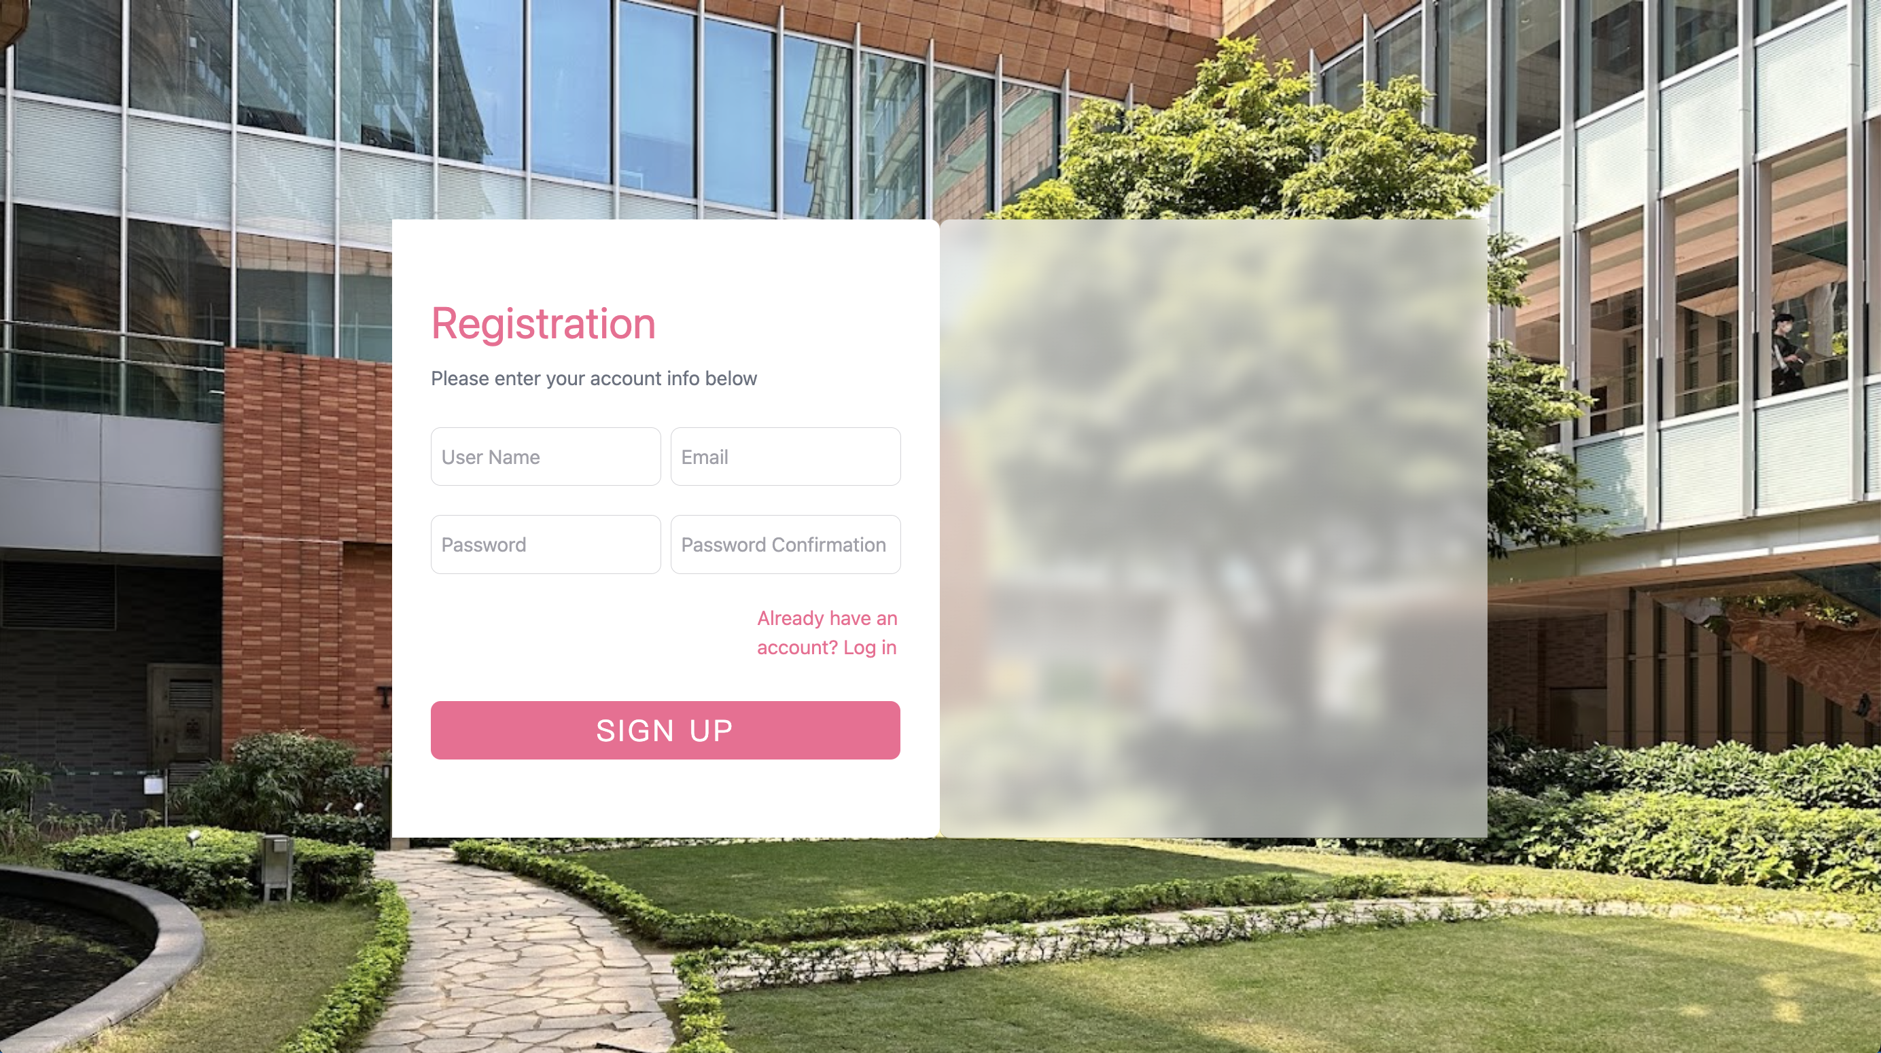
Last week work - Front end
Login Page
Registration Page

Slide 3
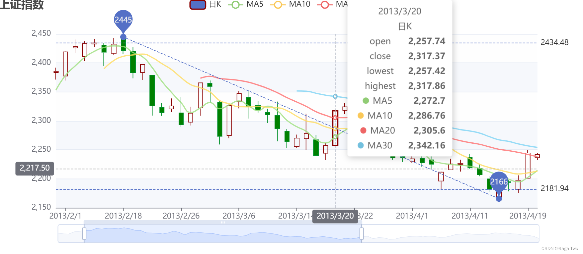
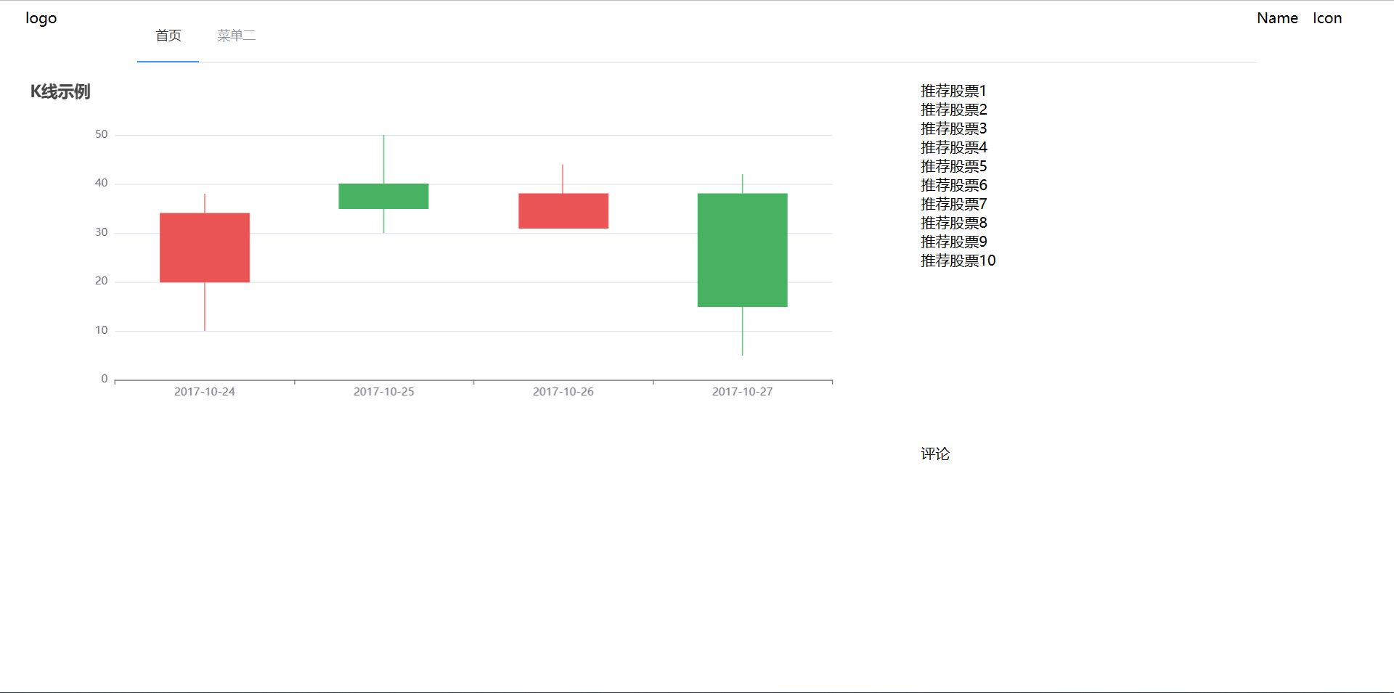
Last week work - Front end
Using static data and using the Echarts tool to
complete the drawing of the K-line diagram.
Using static data and using the Echarts tool to
complete the drawing of the K-line diagram.
Complete the preliminary layout of the page.
The container consists of a header and a main
section, where there is a navigation bar, website
logo, user login information, and more. In the main section of the homepage, there is a complex
k-line chart area for stocks, the top ten stock areas recommended by the recommendation system,
and the comment area below.

Slide 4
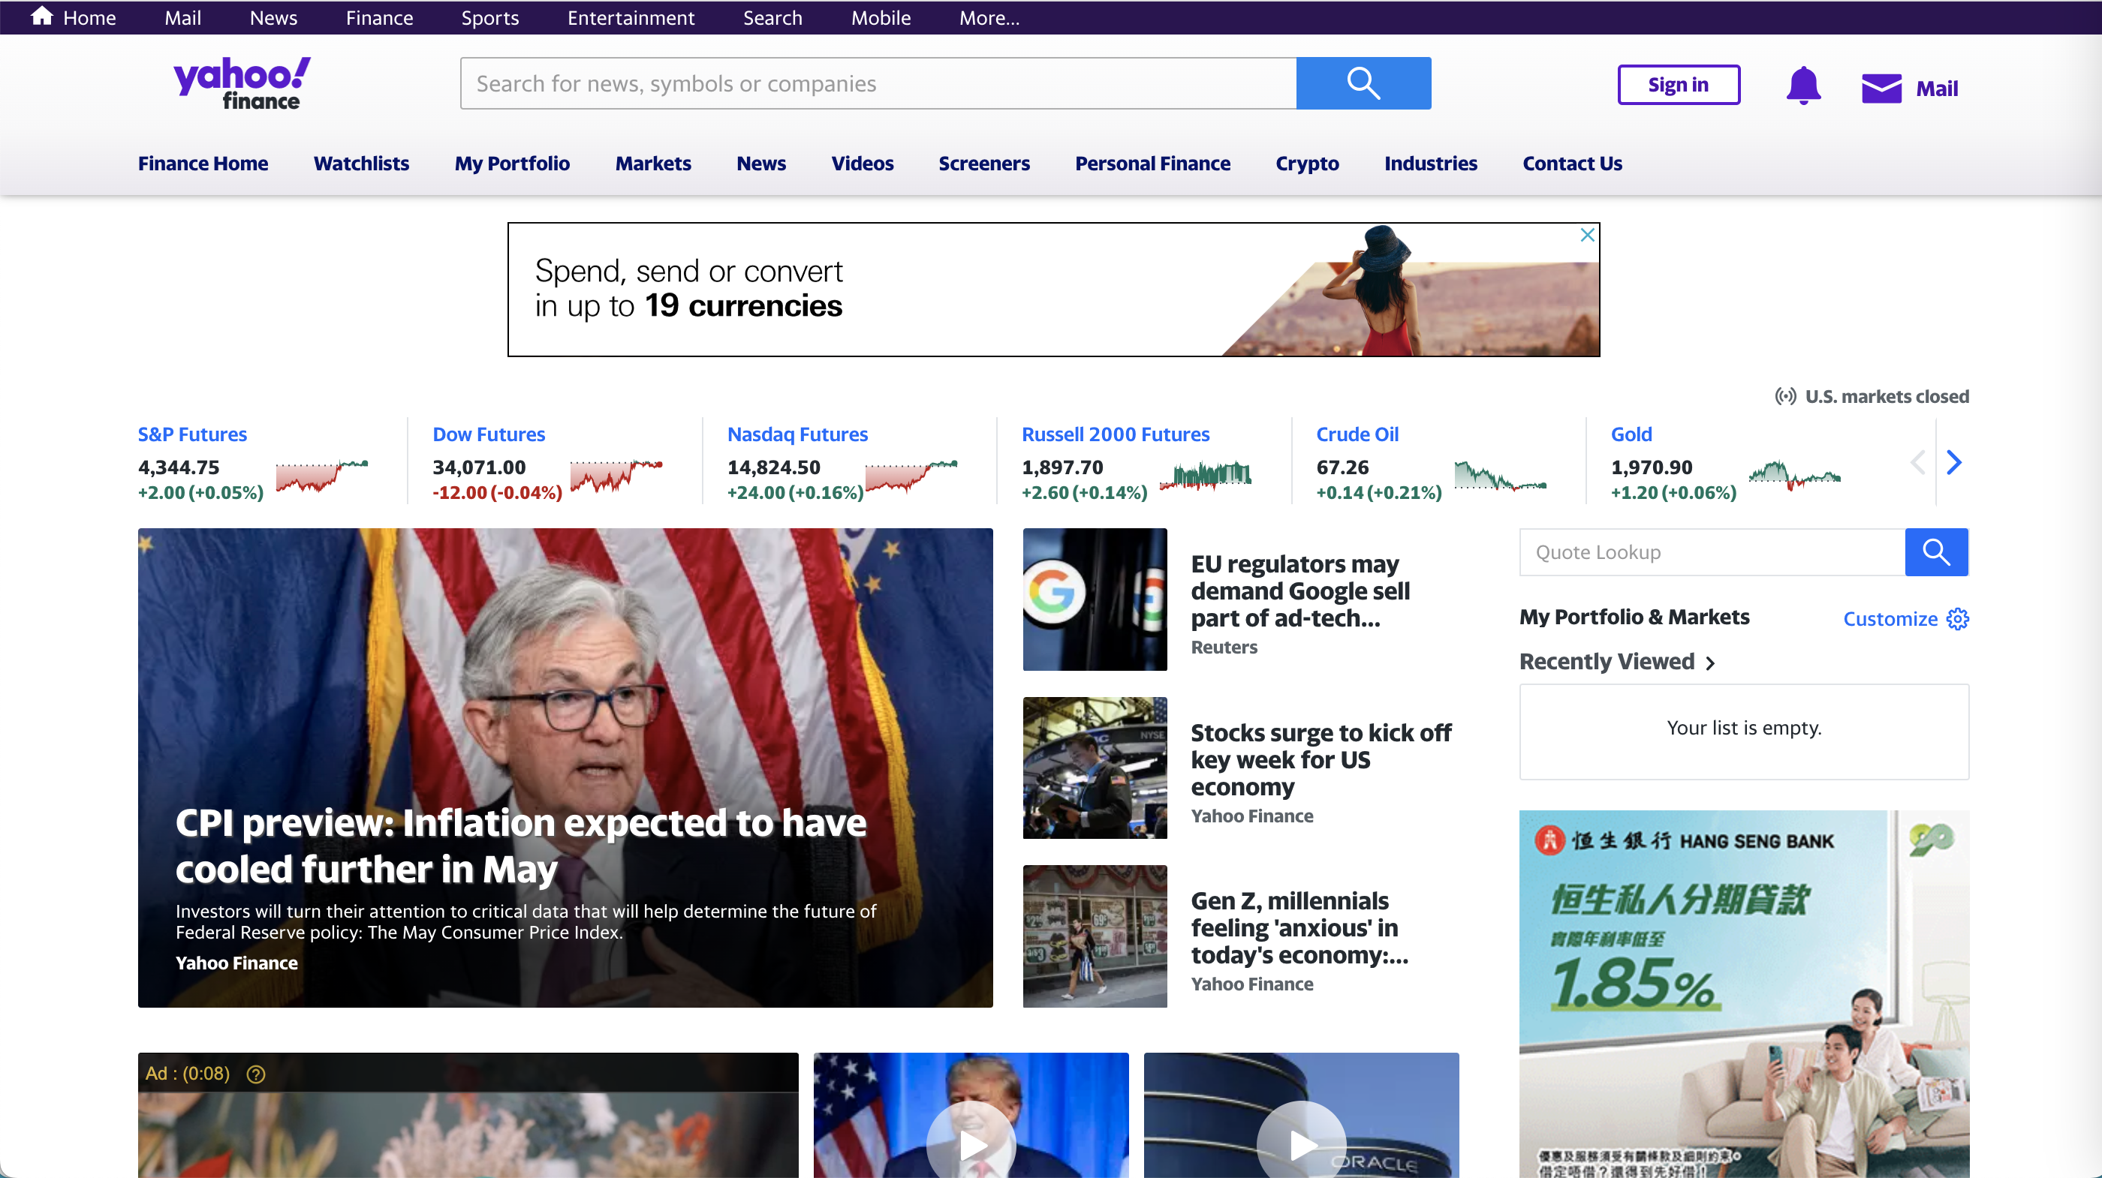
Dataset
yfinance: It's an open-source tool that uses Yahoo's publicly available APIs to get latest financial market data. We will use this libarary to obtain our stock dataset from yahoo finance website.

Slide 5
Dataset for Backend
To implement query asynchronously from main backend server used Java, we create query task through message queue (In our system, it is the rabbitmq clusters deployed in 4 servers.)
Pika in python has been used as the listener of the new task.
When the query from yahoo through yfinance is over, the result will also be added to the message queue listened by Spring Boot.
import pika import yfinance as yf import json from utils.r import R def callback(ch, method, properties, body): r = json.loads(body) code = r['code'] sh = yf.Ticker(code) hist = sh.history(period="25h", interval="1h") a = [] for index, row in hist.iterrows(): d = row.to_dict() d['Time'] = str(index) a.append(d) if len(hist) > 0: r = R.ok(code).set_data(a) ch.basic_publish(exchange='', routing_key="k-data-result", body=json.dumps(r)) ch.basic_ack(delivery_tag=method.delivery_tag) def main(): connection = pika.BlockingConnection(pika.ConnectionParameters('localhost')) channel = connection.channel() channel.basic_consume(queue='k-data-query', on_message_callback=callback, auto_ack=False) channel.start_consuming() if __name__ == '__main__': main()

Slide 6
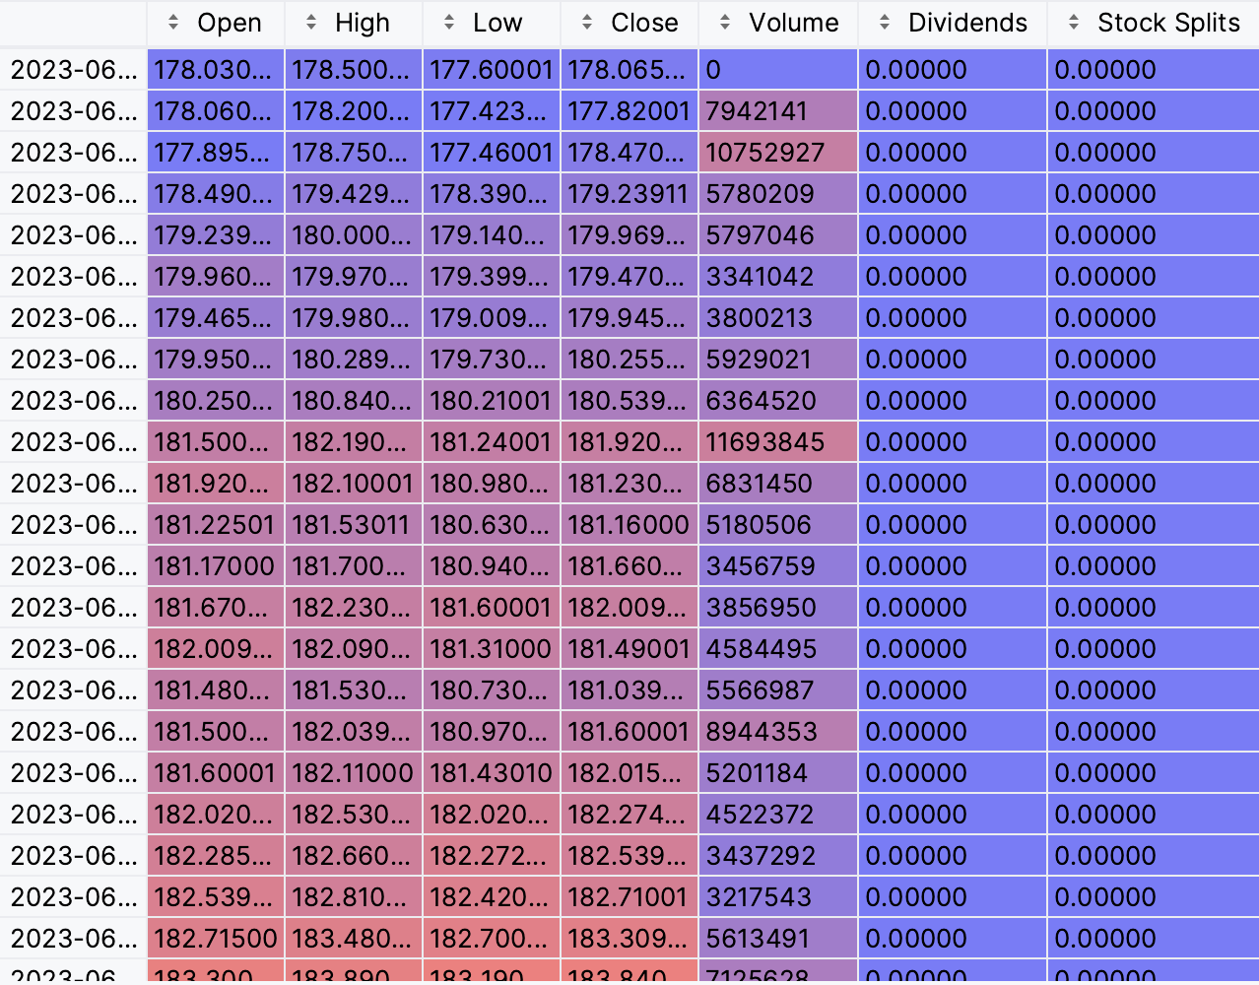
Dataset for Backend
To implement query asynchronously from main backend server used Java, we create query task through message queue (In our system, it is the rabbitmq clusters deployed in 4 servers.)
Pika in python has been used as the listener of the new task.
When the query from yahoo through yfinance is over, the result will also be added to the message queue listened by Spring Boot.
def main(): connection = pika.BlockingConnection(pika.ConnectionParameters('localhost')) channel = connection.channel() channel.basic_consume(queue='k-data-query', on_message_callback=callback, auto_ack=False) channel.start_consuming() if __name__ == '__main__': main()

Slide 7
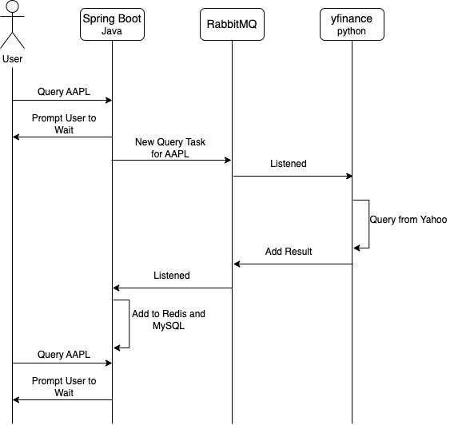
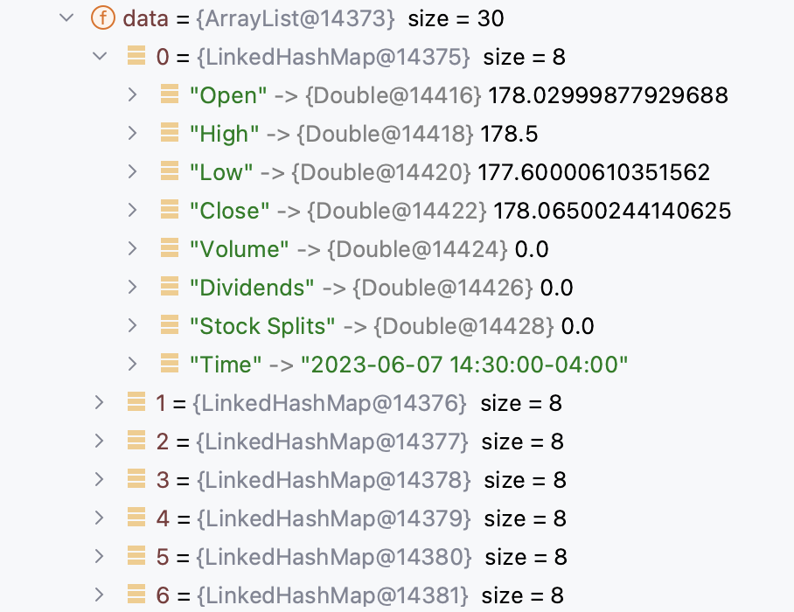
Process of query
Lazy load pattern has been adopted in this function.
@RabbitListener(queues = RabbitConfiguration.K_DATA_RESULT_QUEUE_NAME) public void saveToDB(Message message, R content, Channel channel) { … }

Slide 8
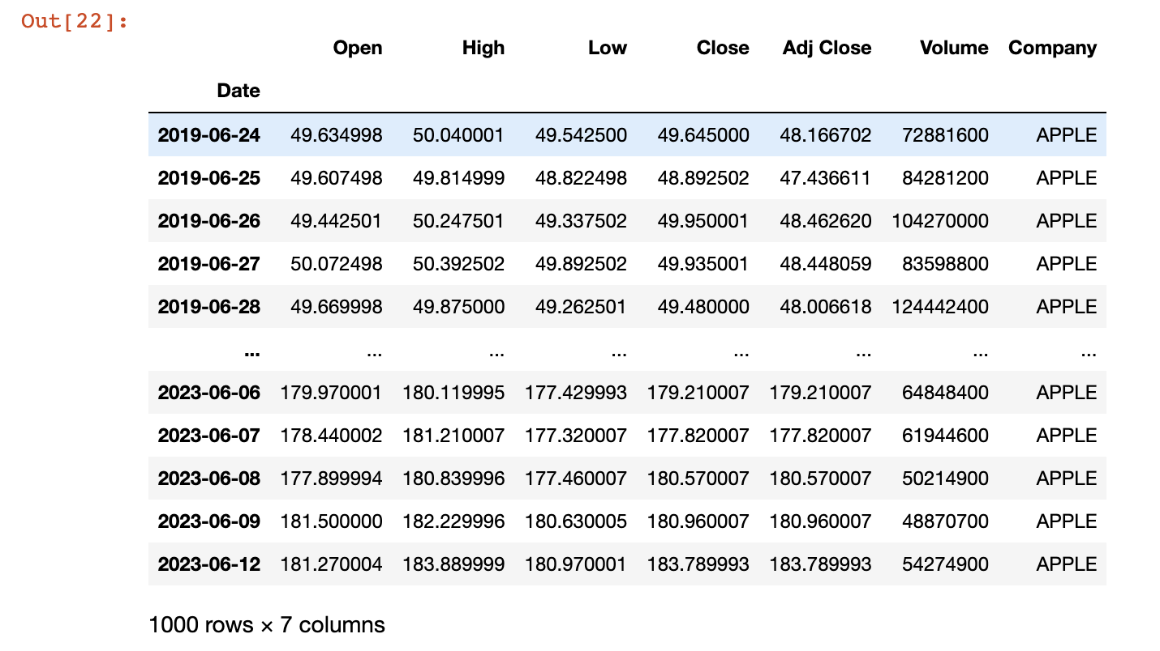
Dataset
An example of the last 1000 working days:

Slide 9
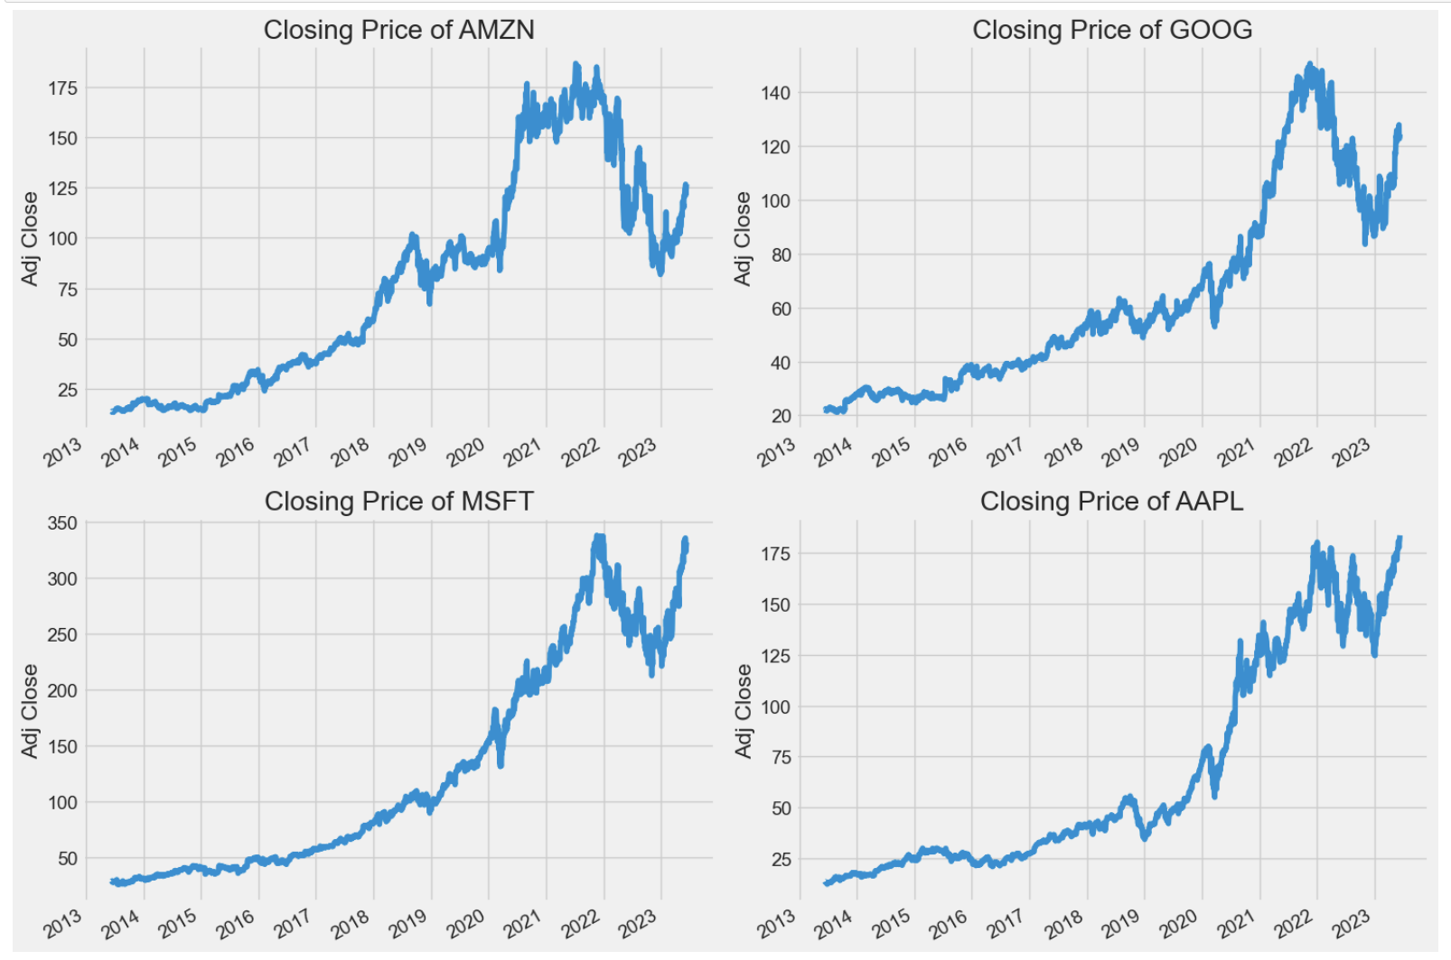
Dataset – Closing Price

Slide 10
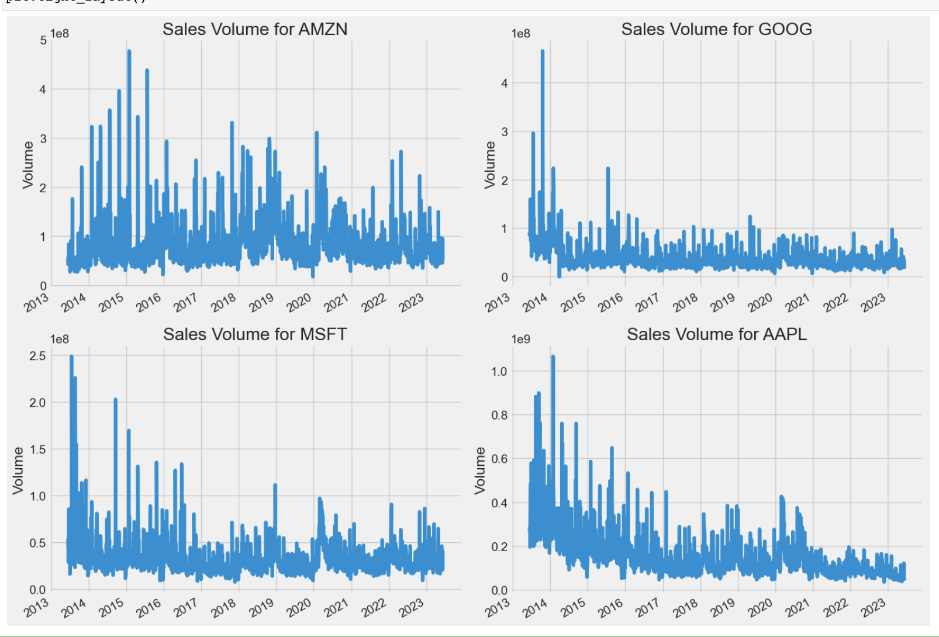
Dataset - Sales Volume

Slide 11
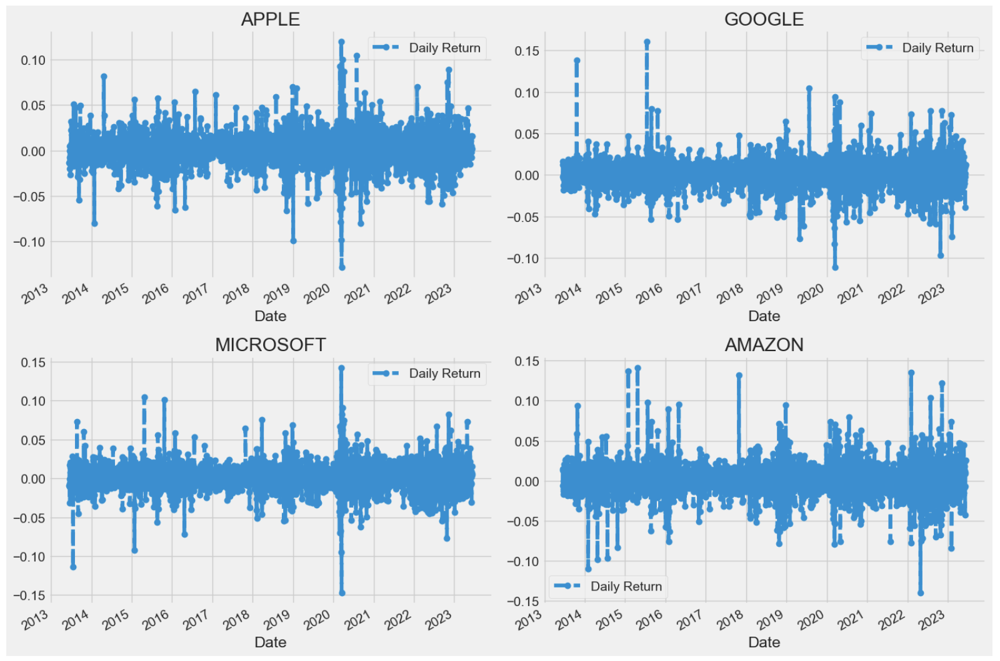
Dataset - Risk
Risk Analysis:

Slide 12
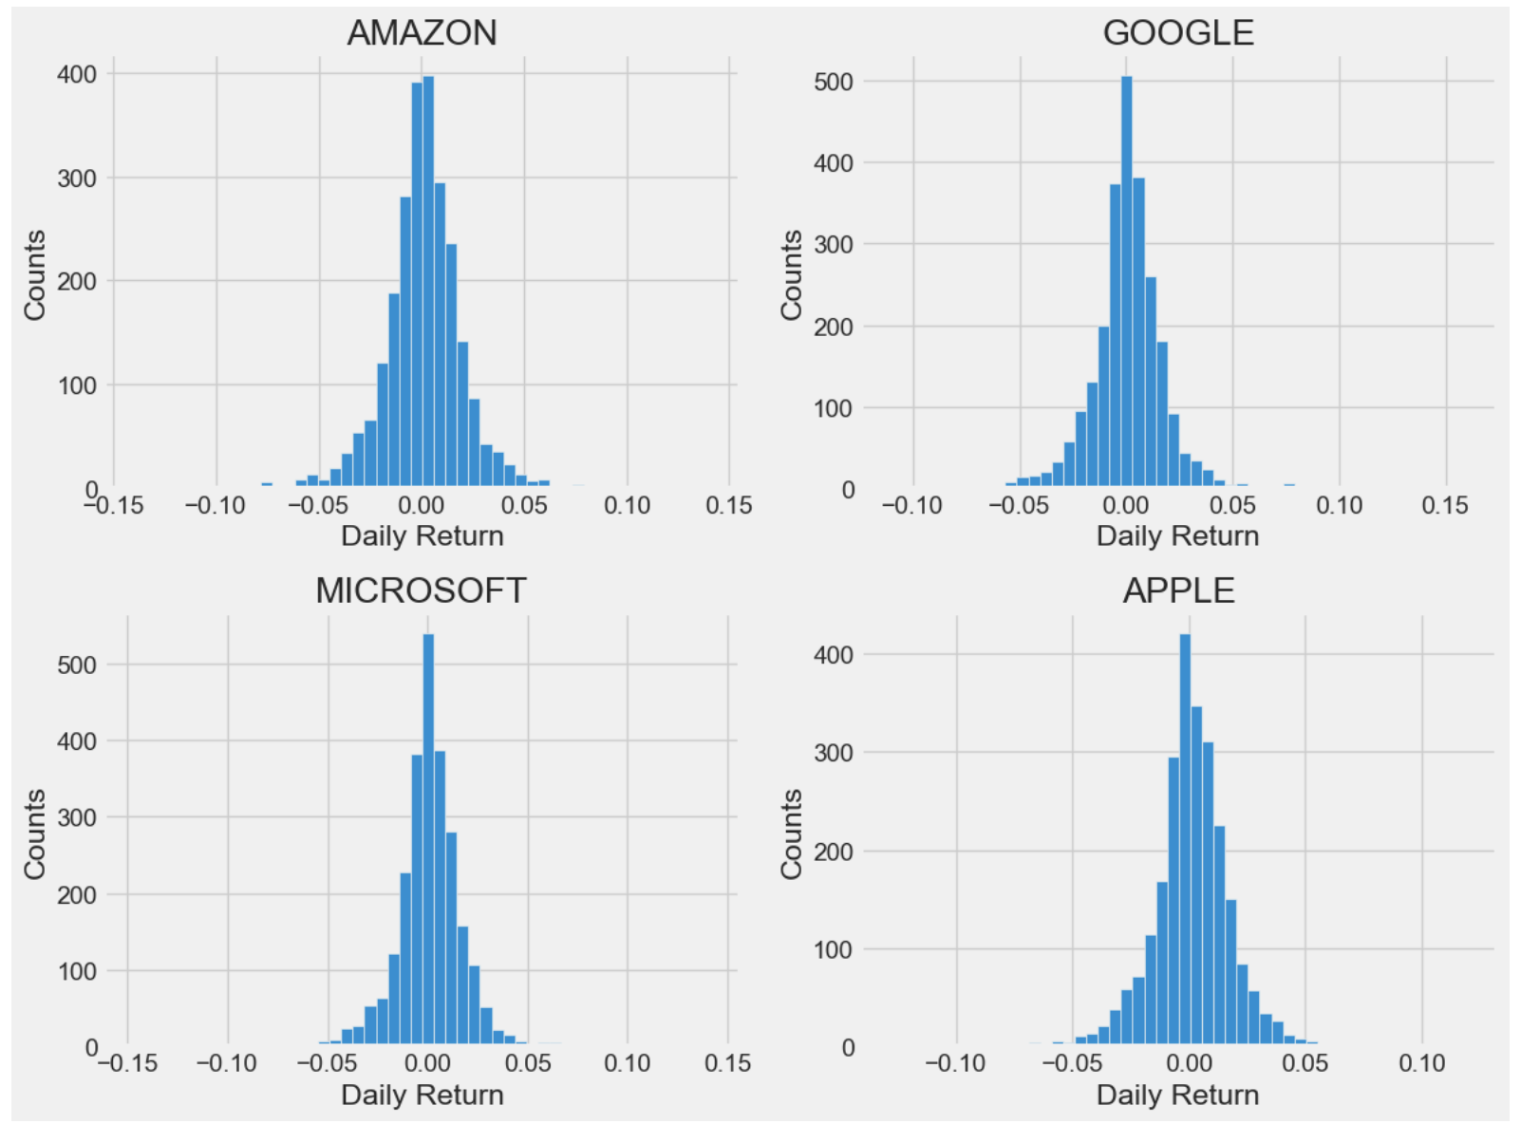
Dataset – Daily Return

Slide 13
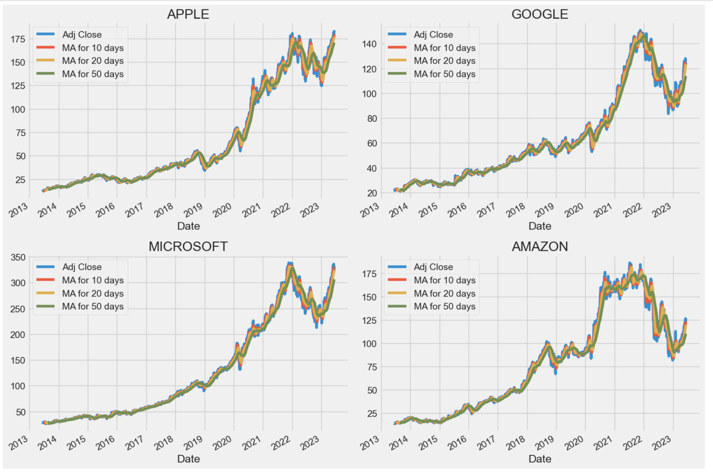
Dataset – Moving Average
Moving average: In finance, moving averages are often used by technical analysts to keep track of price trends for specific securities.

Slide 14
Expanded Features Design
Backend functions:
WeChat alerts
imitate trading
k-line statistics
Algorithm:
Complete stock price prediction algorithm

Slide 15
Plan
Tasks |  | Estimated completion time | Estimated number of learning hours
1 | Data Collection | 1 week | 15
2 | Data Preprocessing | 1 week | 20
3 | Feature Selection | 1 week | 20
4 | Model Development | 2 weeks | 80
5 | Model Evaluation | 1 week | 20
6 | Graphical Representation | 1 weeks | 35
7 | User Interface Development | 2 weeks | 35
8 | Real-time Data Integration | 1 week | 40
9 | System Testing | 1 week | 15
10 | Deployment & Maintenance | 1 week | 20
 |  |  | Total: 300

